Slide 1

UNIT-4
OOPS Concepts
Python Programming
Unit 4
Department of CSE
Notes:
You can safely remove this slide. This slide design was provided by SlideModel.com – You can download more templates, shapes and elements for PowerPoint from http://slidemodel.com

Slide 2


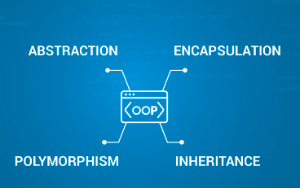
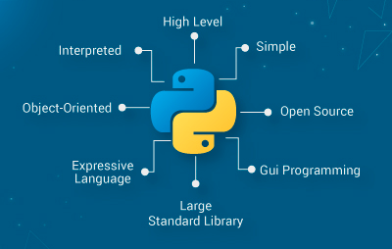
Object Oriented programming (OOP)
The term “Object-Oriented Programming” (OOP) was coined by Alan Kay around 1966. The language called Simula was the first programming language with the features of Object-oriented programming. It was developed in 1967 for making simulation programs, in which the most important information was called objects.
Though OOPs were in the market since the early 1960s it was in the 1990s that OOPs began to grow because of C++. After that, this technique of programming has been adapted by various programming languages including Python
Python Programming
Unit 4
Department of CSE

Slide 3
The main aim of object-oriented programming is to implement real-world entities,
for example, object, classes, abstraction, inheritance, polymorphism, etc.
OOPs (Object-Oriented Programming System).
Object means a real-world entity such as a pen, chair, table, computer, watch, etc.
Object-Oriented Programming is a methodology or paradigm to design a program using classes and objects.
It simplifies software development and maintenance by providing some concepts:
Object
Class
Inheritance
Polymorphism
Abstraction
Encapsulation
Object Oriented programming (OOP)

Slide 4
Need for OOP Paradigm
OOP is an approach to program organization and development, which attempts to eliminate some of the drawbacks of conventional programming methods by incorporating the best of structured programming features with several new concepts.
OOP allows us to decompose a problem into number of entities called objects and then build data and methods (functions) around these entities.
The data of an object can be accessed only by the methods associated with the object.
Object-oriented programming (OOP) is a programming paradigm that uses “Objects “and their interactions to design applications.
It simplifies the software development and maintenance by providing some concepts:
Object
Class
Data Abstraction & Encapsulation
Inheritance
Polymorphism

Slide 5
Objects are the basic run time entities in an object oriented system. They may represent a person, a place, a bank account, a table of data or any item that the program has to handle.
Class are data types based on which objects are created. Objects with similar properties and methods are grouped together to form a Class. Thus a Class represents a set of individual objects.
Characteristics of an object are represented in a class as Properties. The actions that can be performed by objects become functions of the class and is referred to as Methods.
Example: class fruit
objects: mango, banana, apple etc.
Data abstraction
Abstraction refers to the act of representing essential features without including the background details or explanations. since the classes use the concept of data abstraction ,they are known as abstraction data type(ADT).
For example, a class Car would be made up of an Engine, Gearbox, Steering objects, and many more components. To build the Car class, one does not need to know how the different components work internally, but only how to interface with them, i.e., send messages to them, receive messages from them, and perhaps make the different objects composing the class interact with each other.

Slide 6
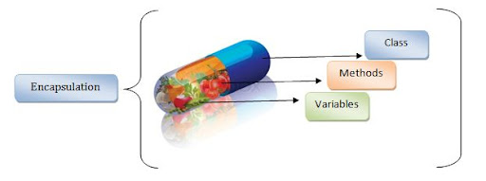
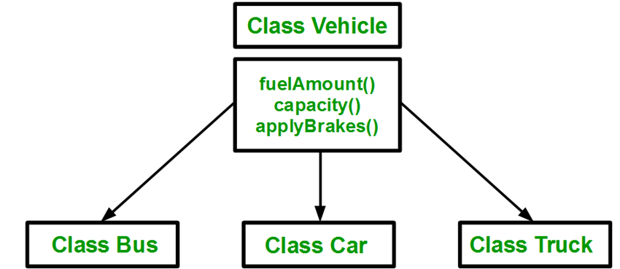
Data Encapsulation
Encapsulation refers to the bundling of data, along with the methods that operate on that data, into a single unit. Many programming languages use encapsulation frequently in the form of classes.
Inheritance
Methods allows to reuse a sequence of statements
Inheritance allows to reuse classes by deriving a new class from an existing one
The existing class is called the parent class, or superclass, or base class
The derived class is called the child class or subclass.
The child class inherits characteristics of the parent class(i.e the child class inherits the methods and data defined for the parent class

Slide 7
Types of inheritances
There are five types of inheritances
Simple Inheritance (or) Single Inheritance
Multiple Inheritance
Multi-Level Inheritance
Hierarchical Inheritance
Hybrid Inheritance
05
Python Programming
Unit 4
Department of CSE - AI&ML, School of Engineering

Slide 8
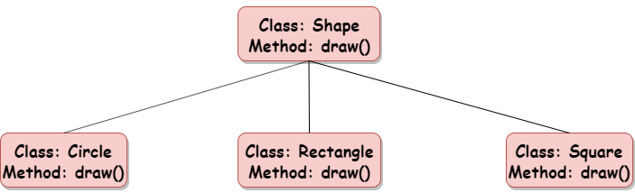
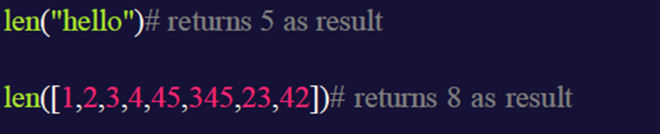
Polymorphism
The word polymorphism means having many forms.
In simple words, we can define polymorphism as the ability of a message to be displayed in more than one form.
Polymorphism is considered one of the important features of Object-Oriented Programming.
Polymorphism allows us to perform a single action in different ways.

Slide 9
Constructor
A constructor is a special method of a class or structure in object-oriented programming that initializes a newly created object of that type. Whenever an object is created, the constructor is called automatically.
Examples of Python Constructor
1.class Python1:
def __init__(self):
print("Object Created for the Class Python1")
obj1 = Python1()
2. class Dress:
def __init__(self):
self.cloth = "Cotton"
self.type = "T-Shirt"
def get_details(self):
return f"Cloth = {self.cloth}\nType = {self.type}"
t_shirt = Dress()
print(t_shirt.get_details())

Slide 10
OOPs in Python
OOPs in Python is a programming approach that focuses on using objects and classes as same as other general programming languages.
The objects can be any real-world entities.
Python allows developers to develop applications using the OOPs approach with the major focus on code reusability.
Class
A class is a blueprint for the object.
We can think of class as a sketch of a parrot with labels.
It contains all the details about the name, colors, size etc. Based on these descriptions, we can study about the parrot.
The example for class of parrot can be :
Syntax: class classname: ex: class Parrot:
statement pass
05
Here, we use the class keyword to define an empty class Parrot. From class, we construct instances. An instance is a specific object created from a particular class.

Slide 11
OOPs in Python
Object:
An object (instance) is an instantiation of a class. When class is defined, only the description for the object is defined. Therefore, no memory or storage is allocated.
The example for object of parrot class can be:
obj = Parrot()
05

Slide 12

Example:
class Parrot:
# class attribute
species = "bird“
# instance attribute
def __init__(self, name, age):
self.name = name
self.age = age
Output
# instantiate the Parrot class
blu = Parrot("Blu", 10)
woo = Parrot("Woo", 15)
# access the class attributes
print("Blu is a {}".format(blu.__class__.species))
print("Woo is also a {}".format(woo.__class__.species))
# access the instance attributes
print("{} is {} years old".format( blu.name, blu.age))
print("{} is {} years old".format( woo.name, woo.age))
05

Slide 13

Constructor:
The constructor is a method that is called when an object is created. This method is defined in the class and can be used to initialize basic variables.
If you create four objects, the class constructor is called four times.
Every class has a constructor, but its not required to explicitly define it.
Example:
class Human:
def__init__(self):
self.legs = 2
self.arms = 2
bob = Human()
print(bob.legs)
Each time an object is created a method is called. That methods is named the constructor.
The constructor is created with the function init.
As parameter we write the self keyword, which refers to itself (the object).
05

Slide 14
Example for Constructor
Lets say you have a class Plane, which upon creation should start flying.
The steps involved in taking off: accelerating, changing flaps, closing the wheels and so on.
The default actions can be defined in methods. These methods can be called in the constructor.
class Plane:
def__init__(self):
self.wings = 2
# fly
self.drive()
self.flaps()
self.wheels()
def drive(self):
print('Accelerating’)
def flaps(self):
print('Changing flaps’)
def wheels(self):
print('Closing wheels')
ba = Plane()
To summarize
A constructor is called if you create an object.
In the constructor you can set variables and
call methods.
05

Slide 15
Creating multiple objects from one class, will call the same constructor.
classBug:
def__init__(self):
self.wings = 4
classHuman:
def__init__(self):
self.legs = 2
self.arms = 2
bob = Human()
tom = Bug()
print(tom.wings)
print(bob.arms)
The constructor of a class is unique: initiating objects from different classes will call different constructors.
Default values of newly created objects can be set in the constructor.
The example below shows two classes with constructors.
Then two objects are created but different constructors are called.
05

Slide 16
Python Variable Types: Local & Global
Global variables are those which are not defined inside any function and have a global scope.
local variables are those which are defined inside a function and its scope is limited to that function only.
Local Variable : Examples
def f():
# local vairable
s = “Data Science"
print("Inside Function:", s)
# Driver code
f()
print(s) // Error since local variable used outside function
def f():
# local vairable
s = “Data Science"
print(s)
# Driver code
f()
05

Slide 17
Global declaration
x = "global"
def foo():
print("x inside:", x)
foo()
print("x outside:", x)
Output:
x inside: global
x outside: global
Using Global and Local variables in the same code
x = "global "
def foo():
global x
y = "local"
x = x * 2
print(x)
print(y)
foo()
Output:
global global
local

Slide 18
Types of methods:
In Object-Oriented Programming, we have objects.
objects consist of properties and behavior.
properties of the object are defined by the attributes and the behavior is defined using methods. these methods are defined inside a class.
These methods are the reusable piece of code that can be invoked/called at any point in the program.
Generally, there are three types of methods in Python:
1. Instance Methods.
2. Class Methods
3. Static Methods
05

Slide 19
Instance(object) Method
This is a very basic and easy method.
If we want to print an instance variable or instance method we must create an object of that required class.
If we are using self as a function parameter or in front of a variable, that is nothing but the calling instance itself.
As we are working with instance variables we use self keyword.
Note: Instance variables are used with instance methods.
# Instance Method Example in Python
class Student:
def __init__(self, a, b):
self.a = a
self.b = b
def avg(self):
return (self.a + self.b)/2
s1 = Student(10,20)
print( s1.avg())
class My_class:
def instance_method(self):
return "This is an instance method.“
obj = My_class()
obj.instance_method()
Output:
?
Output:
15.0
05

Slide 20
Class Method
The purpose of the class methods is to set or get the details (status) of the class.
They can’t access or modify specific instance data
They are bound to the class instead of their objects.
classsmethod() function returns a class method as output for the given function.
Here is the syntax for it:
classmethod(function)
The classmethod() method takes only a function as an input parameter and converts that into a class method.
There are two ways to create class methods in python:
Using classmethod(function)
2. Using @classmethod annotation
05

Slide 21
Class Method
As we are working with ClassMethod we use the cls keyword.
# Class Method Implementation in python
class Student:
name ='Student’
def __init__(self, a, b):
self.a = a
self.b = b
@classmethod
def info(cls):
return cls.name
print(Student.info())
Output
Student
05

Slide 22
Static Method
A static method can be called without an object for that class, using the class name directly.
# Static Method Implementation in python
Class Student:
name ='Student’
def__init__(self, a, b):
self.a = a
self.b = b
@staticmethod
def info():
return"This is a student class“
print(Student.info())
Output
This is a student class
05

Slide 23

Inheritance :
Syntax:
Simple Inheritance (or) Single Inheritance : one child class derives from one parent class.
class ParentClass:
def feature_1(self):
print('feature_1 from ParentClass is running...’)
def feature_2(self):
print('feature_2 from ParentClass is running...’)
class ChildClass(ParentClass):
def feature_3(self):
print('feature_3 from ChildClass is running...’)
obj = ChildClass()
obj.feature_1()
obj.feature_2()
obj.feature_3()
Output:
feature_1 from ParentClass is running..
feature_2 from ParentClass is running..
feature_3 from ParentClass is running..
05

Slide 24
one child class derives from two or more parent classes.
Multiple Inheritance:
#definition of the class starts here
class Person:
#defining constructor
def __init__(self, personName, personAge):
self.name = personName
self.age = personAge
#defining class methods
def showName(self):
print(self.name)
def showAge(self):
print(self.age)
#end of class definition
# defining another class
class Student: # Person is the
def __init__(self, studentId):
self.studentId = studentId
def getId(self):
return self.studentId
class Resident(Person, Student): # extends both Person and Student class
def __init__(self, name, age, id):
Person.__init__(self, name, age)
Student.__init__(self, id)
# Create an object of the subclass
resident1 = Resident('John', 30, '102')
resident1.showName()
print(resident1.getId())
Output:
John
102
But here in multiple inheritance we have a problem called
“The Diamond Problem”
05

Slide 25
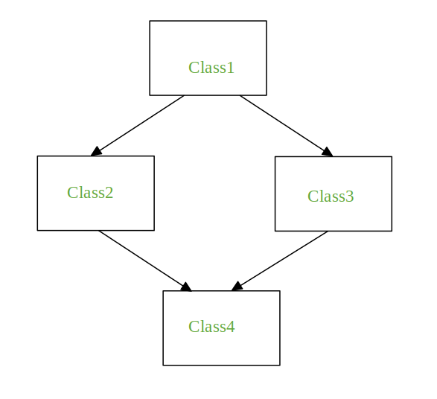
class Class1:
def m(self):
print("In Class1")
class Class2(Class1):
def m(self):
print("In Class2")
class Class3(Class1):
def m(self):
print("In Class3")
class Class4(Class2, Class3):
pass
obj = Class4()
obj.m()
Output:
In Class2

Slide 26
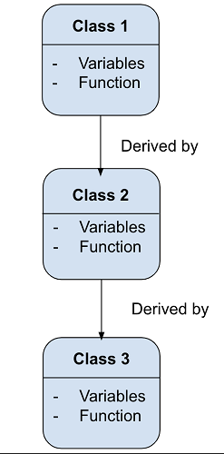
: child class derives from a class which already derived from another class.
Multi-Level Inheritance
class Family:
def show_family(self):
print("This is our family:")
# Father class inherited from Family
class Father(Family):
fathername = ""
def show_father(self):
print(self.fathername)
# Mother class inherited from Family
class Mother(Family):
mothername = ""
def show_mother(self):
print(self.mothername)
# Son class inherited from Father and Mother classes
class Son(Father, Mother):
def show_parent(self):
print("Father :", self.fathername)
print("Mother :", self.mothername)
s1 = Son() # Object of Son class
s1.fathername = "Mark"
s1.mothername = "Sonia"
s1.show_family()
s1.show_parent()
05

Slide 27
Two or more child classes derive from one parent class
Hierarchical Inheritance:
Hybrid Inheritance: consisting of multiple types of inheritance is called hybrid inheritance.
Assignment 1: Implement Hierarchical inheritance using python program?
Implement Hybrid inheritance using python program?
05

Slide 28
Method Overriding
Method overriding or function overriding is a type of polymorphism in which we can define a number of methods with the same name but with a different number of parameters as well as parameters can be of different types.
class Square:
side =5
def calculate_area(self):
return self.side * self.side
class Triangle:
base =5
height =4
def calculate_area(self):
return0.5* self.base * self.height
sq = Square()
tri=Triangle()
print("Areaofsquare:",sq.calculate_area())
print("Areaoftriangle:",tri.calculate_area())
Output:
Area of square: 25
Area Of triangle: 10.0
05

Slide 29
Abstraction :
Consider Example of opening Bank Account for a Person.
Available Data of a Person
Name
Address
Age
Contact Number
Hobbies
Qualification
Blood Group
Available Data of a Person
Name
Address
Age
Contact Number
Required Data to open Account

Slide 30
Example Program for Abstraction
class Person:
def __init__(self):
self.name = “Madhu"
def bio(self):
self.addr = “Gudlapochampally,Hyd"
self.taxInfo = "HUAPK29971"
self.contact = "01-777-523-342"
print(self.addr, self.taxInfo, self.contact)
obj=Person()
print(obj.name)
obj.bio()

Slide 31
Comprehensions
List, Tuple, Set, Dictionaries
05
Python Programming
Unit 4
Department of CSE - AI&ML, School of Engineering

Slide 32
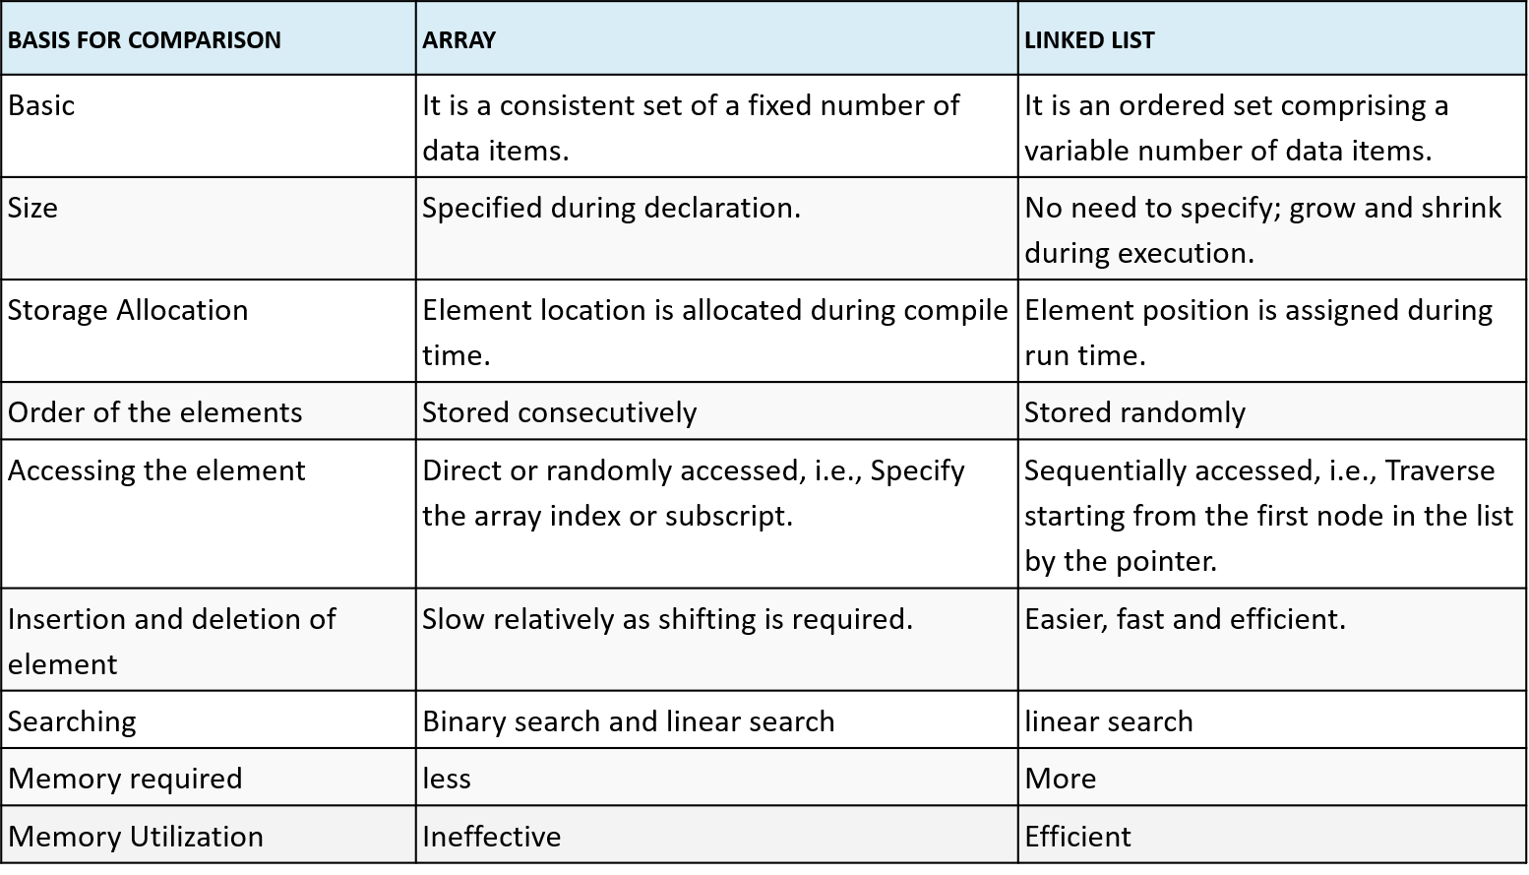
Arrays Vs List
05
Python Programming
Unit 4
Department of CSE - AI&ML, School of Engineering

Slide 33
Thank You

